Slide 1
WBS

Slide 2
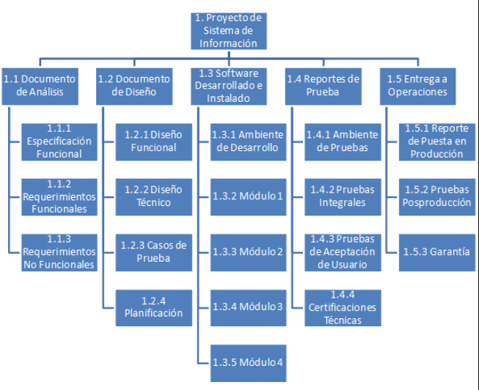
WBS (Work Breakdown Structure)
Descomposición jerárquica de un proyecto con el fin de establecer sus alcances y guiar su ejecución.

Slide 3
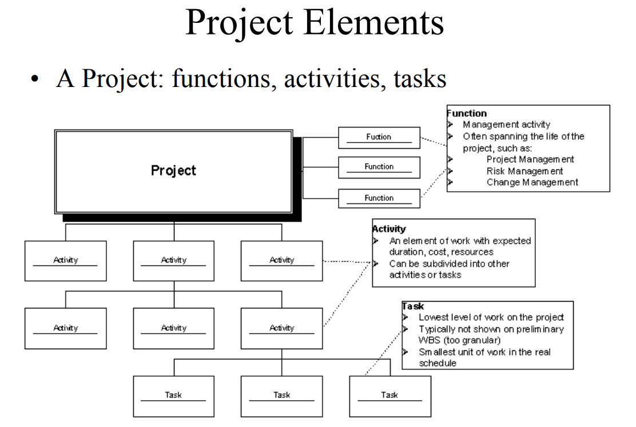
WBS (Work Breakdown Structure)

Slide 4
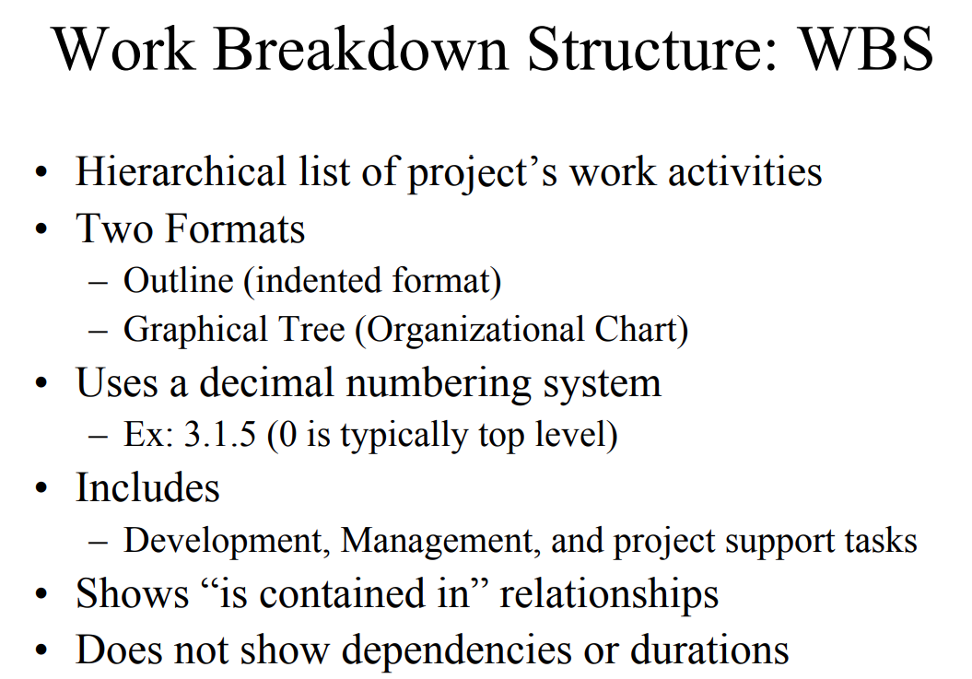
WBS (Work Breakdown Structure)

Slide 5
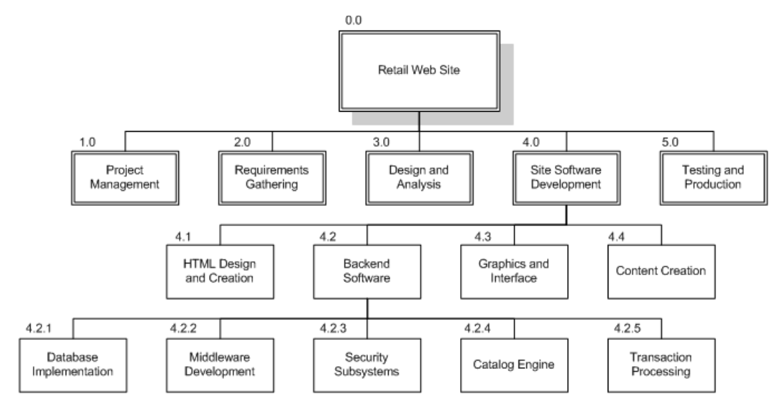
WBS (Work Breakdown Structure)

Slide 6
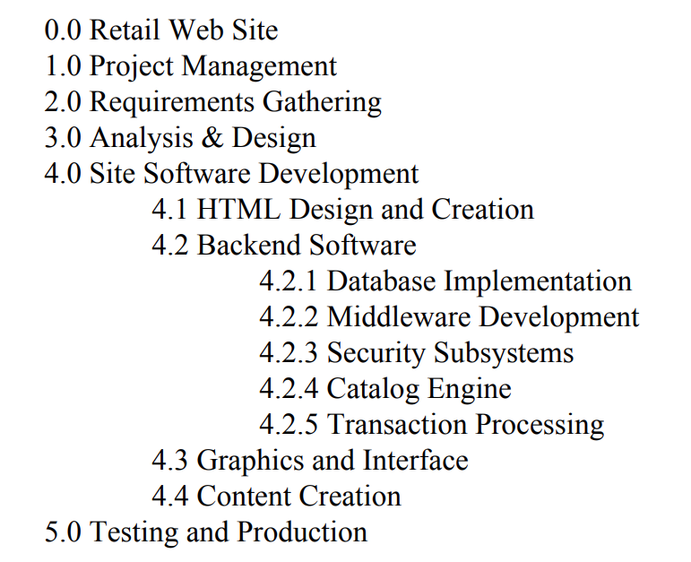
WBS (Work Breakdown Structure)

Slide 7
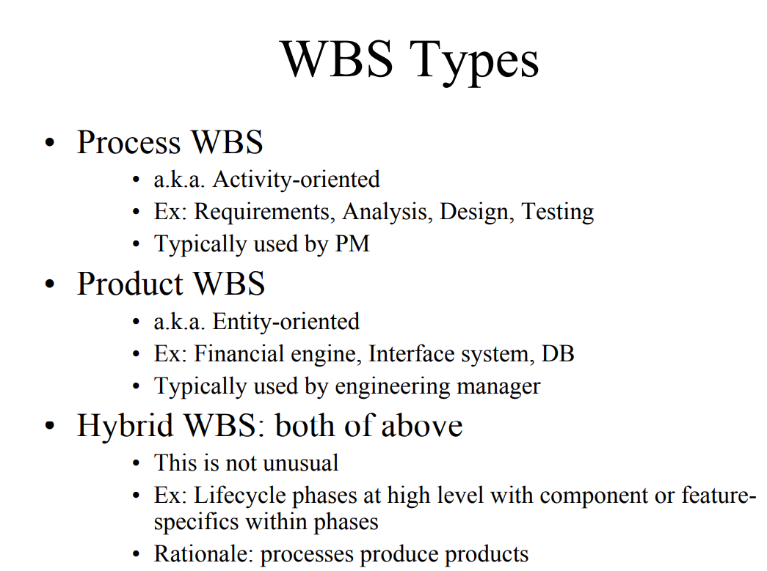
WBS (Work Breakdown Structure)

Slide 8
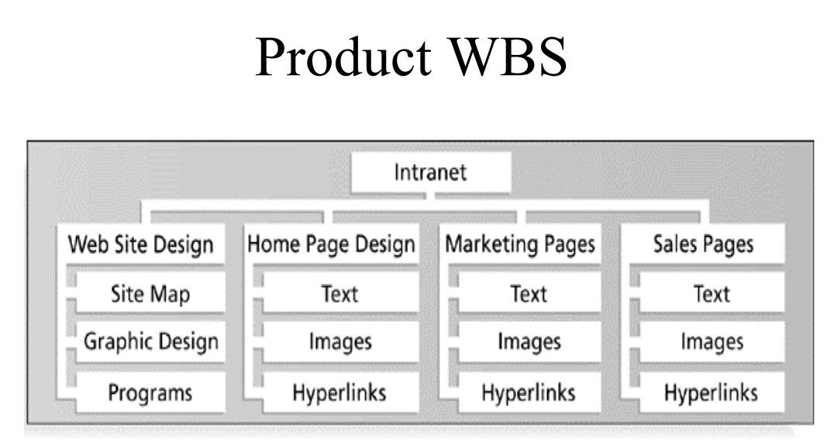
WBS (Work Breakdown Structure)

Slide 9
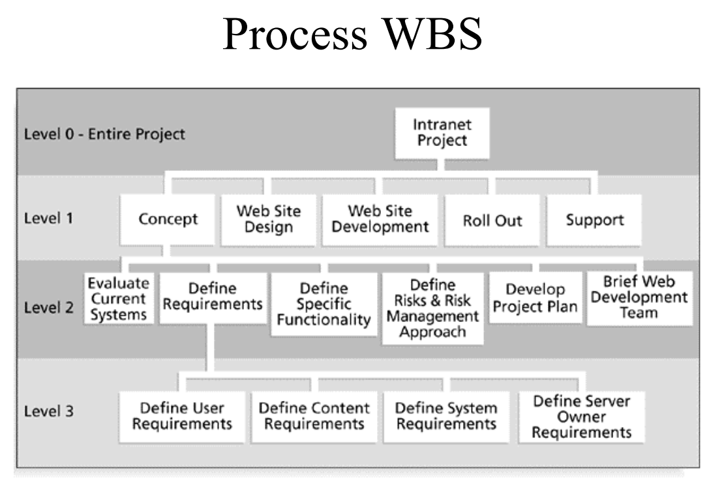
WBS (Work Breakdown Structure)

Slide 10
WBS Online
https://online.visual-paradigm.com/diagrams/features/work-breakdown-structure-software/

